Slide 1

Natural Language Processing tools applied to review articles
Braulio Reyes Suárez

Slide 2
Requirements
If you want, you can install python in your computer through anaconda
free and open-source,
requires registration to download,
requires installation.
If not, you can use Google Colab.
free,
requires a google account,
no installation

Slide 3
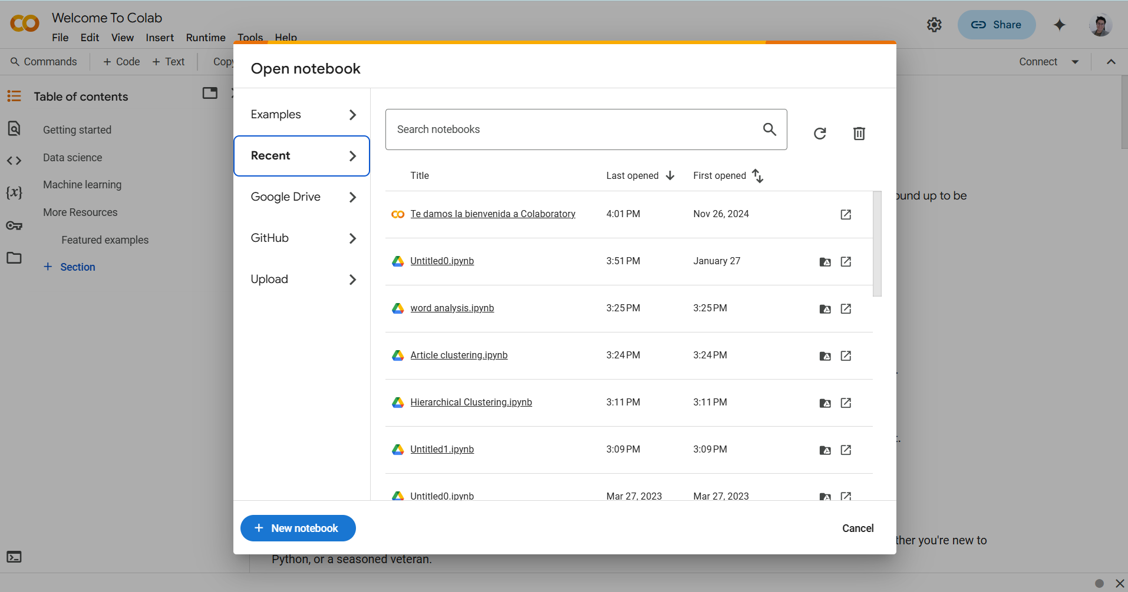
Using Google Colab
As it is the easiest way to work, I will focus on using Google Colab to run the codes that I wrote. First of all we need to go to the main page that should look like this.

Slide 4
Using Google Colab
We exit that window by clicking elsewhere and go to the file tab

Slide 5
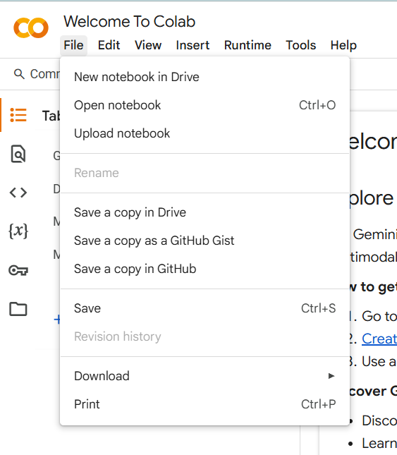
Using Google Colab
We select “Upload Notebook”

Slide 6
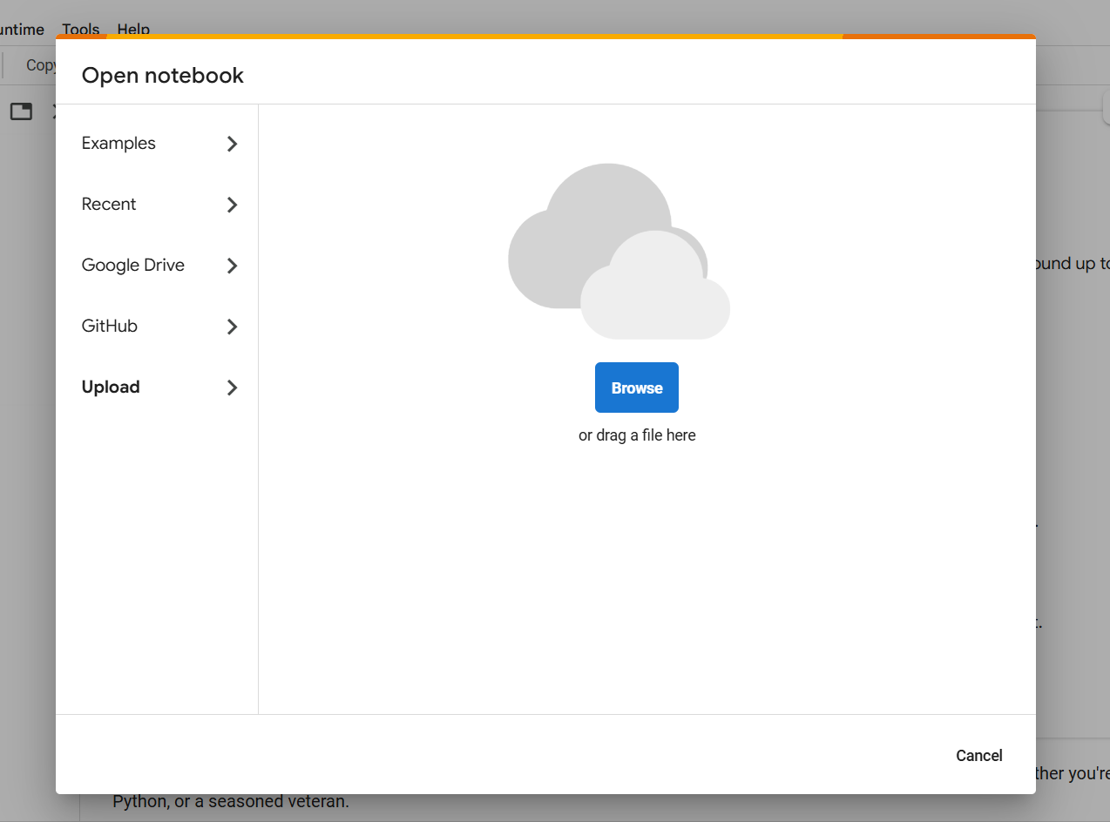
Using Google Colab
Click on “Browse” or drag a file

Slide 7
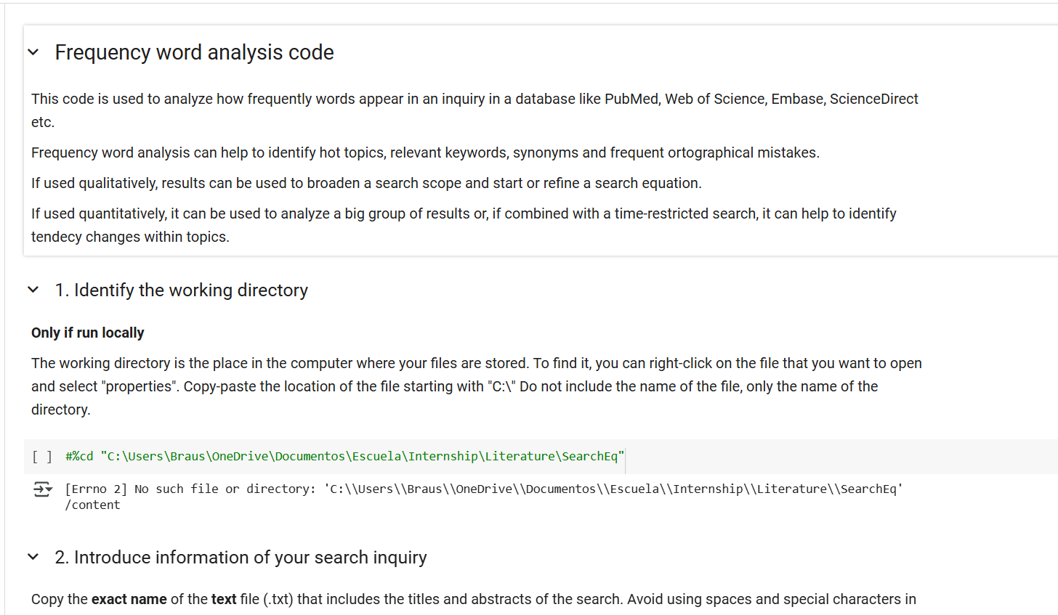
Using Google Colab
Select first the file named “word_analysis compat online.ipnyb”, which should display the following. If you’re running the file online, do not use cell #1.

Slide 8
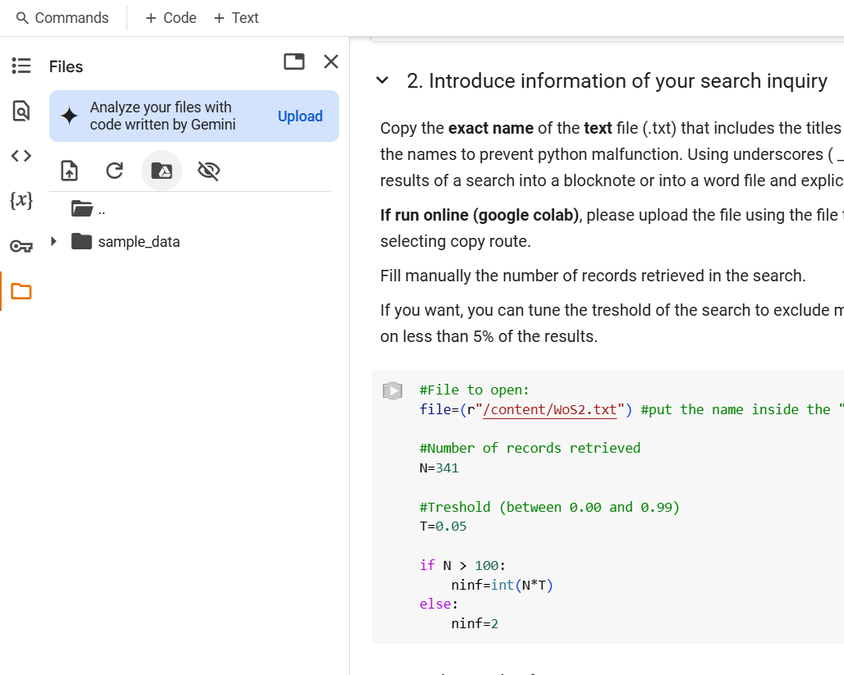
Using Google Colab
Upload the text file you want to use by clicking in the folder icon at the left and then the “upload to session storage button” in the tab that opens. For this example, please use the joint file “WoS2.txt”

Slide 9
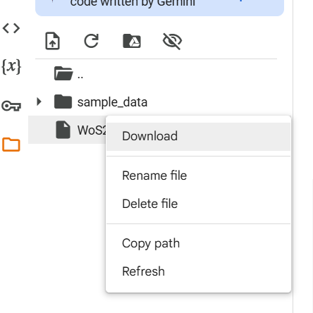
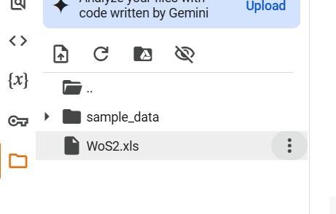
Using Google Colab
Once its uploaded, copy the path by clicking on the three dots and then “copy path”.

Slide 10
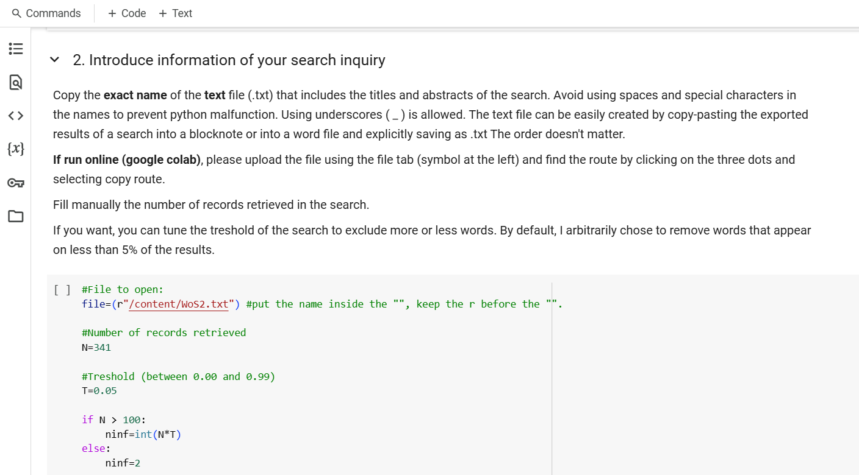
Using Google Colab
In cell #2, introduce the file name (the path we copied in the last slide), number of records and threshold.

Slide 11
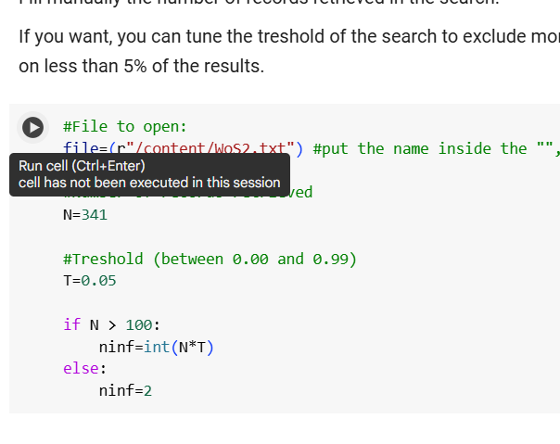
Using Google Colab
Run the cell by clicking on the play button at the left or by clicking Ctrl+Enter

Slide 12
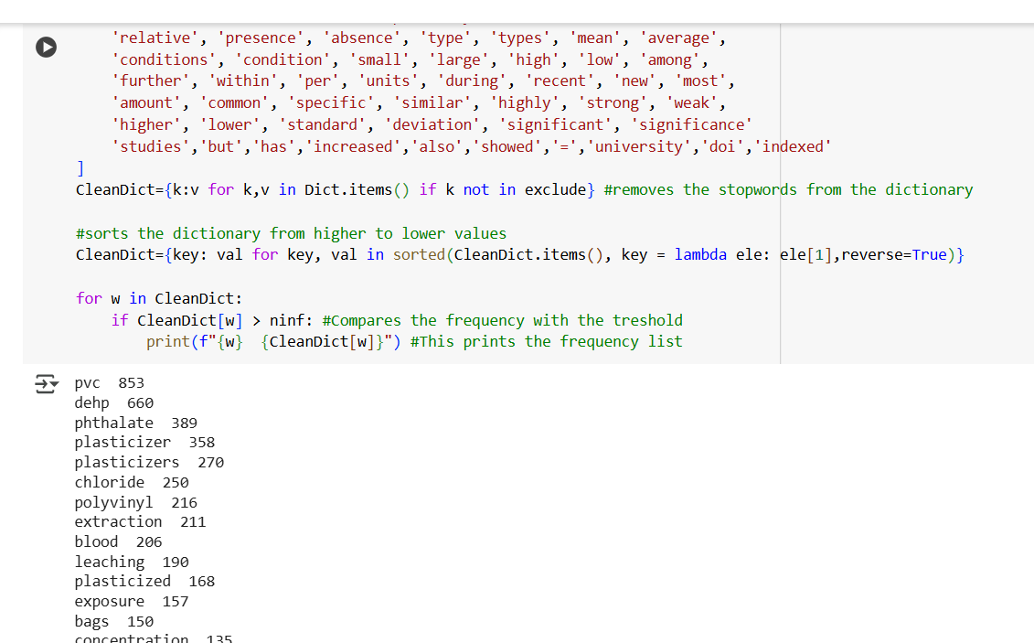
Using Google Colab
Run the rest of the cells by clicking on play or by ctrl+enter. At the end you should obtain the frequency list.

Slide 13
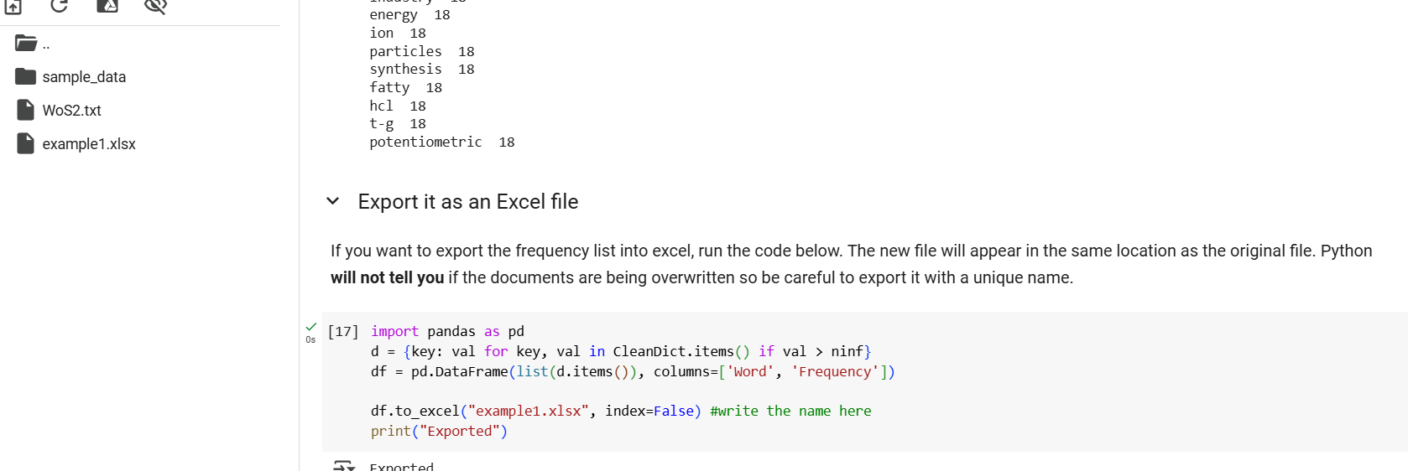
Using Google Colab
Some seconds after running the last cell, you should see a new document on the left. This is the same list but as an excel file. You can download it by clicking on it.

